Slide 1
Introduction to Calculus
Understanding the Fundamentals of Calculus

Slide 2
What is Calculus?
Calculus is a branch of mathematics that focuses on change, motion, and accumulation.
It provides a toolkit for analyzing continuous quantities and their relationships.
Calculus is essential in various fields such as physics, engineering, economics, and computer science.

Slide 3
Differentiation
Differentiation is a fundamental concept in calculus.
It involves finding the rate at which a function changes at a given point.
Differentiation enables us to understand the behavior of functions and solve optimization problems.

Slide 4
Integration
Integration is the reverse process of differentiation.
It involves finding the total accumulation of a quantity over a given interval.
Integration is used to calculate areas, volumes, and solve equations involving rates of change.

Slide 5
Limits
Limits are essential in calculus to understand and analyze functions.
They provide the foundation for differentiation and integration.
Limits allow us to determine the behavior of functions as they approach certain values.

Slide 6
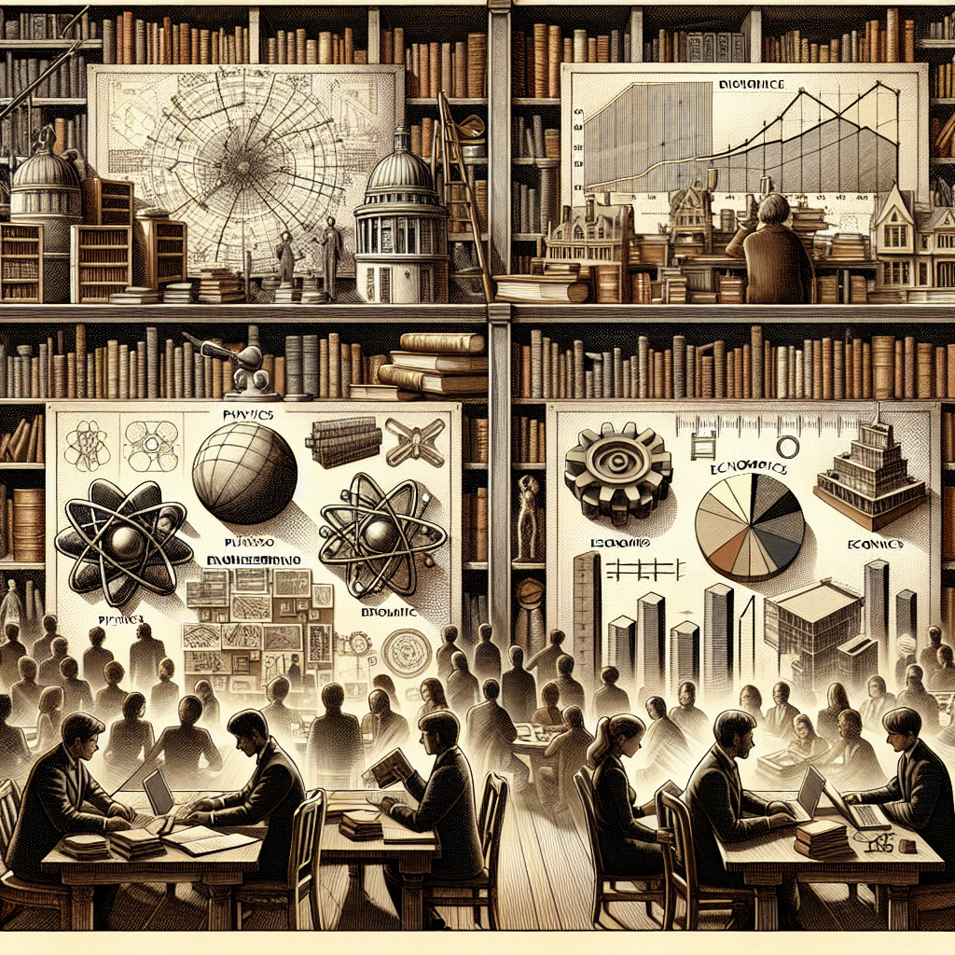
Applications of Calculus
Calculus has numerous applications in various fields.
In physics, calculus is used to understand motion, forces, and energy.
In engineering, calculus is used for modeling and optimization of systems.
In economics, calculus is used to analyze markets and make predictions.
In computer science, calculus is used for algorithms, simulations, and machine learning.
Calculus in Action

Slide 7
Derivatives
Derivatives are a key concept in calculus.
They represent the rate of change of a function at a given point.
Derivatives are used in physics, engineering, and economics to analyze and optimize systems.

Slide 8
Integrals
Integrals are fundamental in calculus.
They represent the accumulation of a quantity over a given interval.
Integrals are used to calculate areas, volumes, and solve real-world problems.

Slide 9
Differential Equations
Differential equations are equations that involve derivatives.
They describe the relationship between a function and its derivatives.
Differential equations are used in physics, engineering, and biology to model and understand natural phenomena.

Slide 10
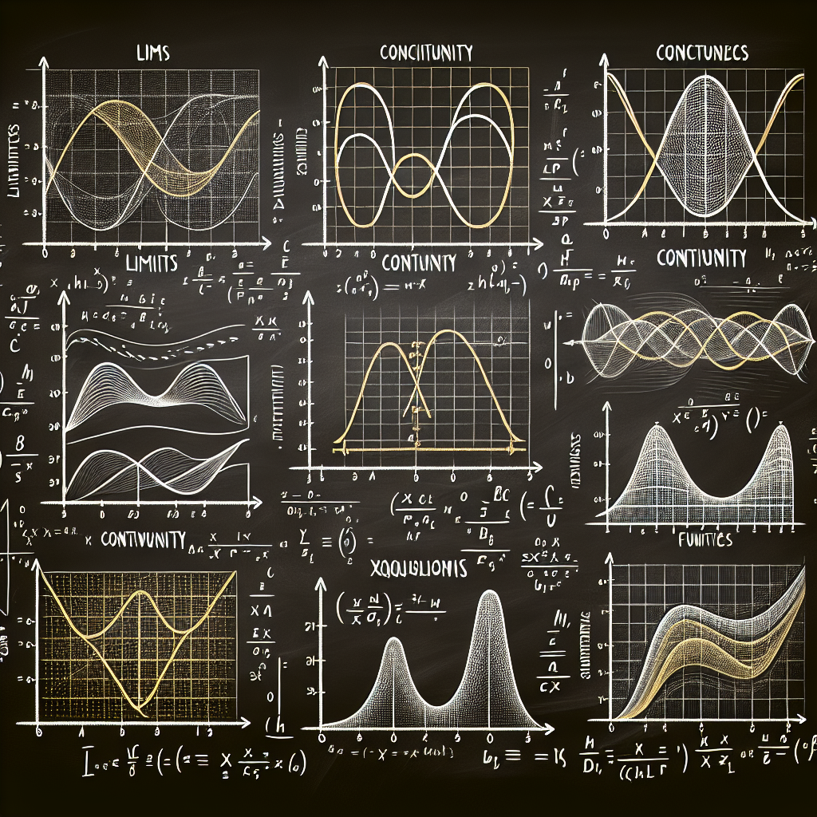
Limits and Continuity
Limits and continuity are fundamental concepts in calculus.
Limits determine the behavior of functions as they approach certain values.
Continuity ensures that functions are smooth and have no abrupt changes.
Finding Limits

Slide 11
Optimization
Optimization is an important application of calculus.
It involves finding the maximum or minimum value of a function.
Optimization is used in various fields such as engineering, economics, and operations research.

Slide 12
Taylor Series
Taylor series are used to represent functions as infinite series.
They allow us to approximate functions and calculate values.
Taylor series are widely used in physics, engineering, and computer science.

Slide 13
Vector Calculus
Vector calculus extends calculus to higher dimensions.
It involves the differentiation and integration of vector-valued functions.
Vector calculus is used in physics, engineering, and computer graphics.

Slide 14
Conclusion
In conclusion, calculus is a powerful branch of mathematics that enables us to understand and analyze change and motion.
With concepts such as differentiation, integration, and limits, calculus provides a framework for solving complex problems and modeling real-world phenomena.
The applications of calculus in various fields highlight its importance and relevance in today's society.

Slide 15
References
1. Stewart, J. (2015). Calculus: Early Transcendentals. Cengage Learning.
2. Anton, H., Bivens, I., & Davis, S. (2012). Calculus. Wiley.
3. Adams, R. A., Essex, C., & Hass, J. (2013). Calculus: A Complete Course. Pearson.

Slide 16
Thank You
Thank you for your attention!
Any questions?

